Slide 1
Fish Freshness Classification Model Performance Report

Slide 2
Introduction
This report presents an analysis of the performance of a fish freshness classification model of Sardine on different dates in local:
The analysis is based on confusion matrices provided for each date.

Slide 3
Confusion Matrix
Actual Values
Good Bad
Good
Bad
TP = True Positives
FP = False Positives
FN = False Negatives
TN = True Negatives
TP | FP
FN | TN
Predicted Values

Slide 4
Performance Metrics
Performance metrics, including accuracy, precision, recall, and F1-score, have been calculated for each date using the provided data and confusion matrices.

Slide 5
Accuracy gives the overall correctness of the predictions.
Precision measures how many of the predicted positive cases were actually positive.
Recall measures how many of the actual positive cases were correctly predicted.
F1-score is the harmonic mean of precision and recall and provides a balance between them.

Slide 6
Metrics Calculation
Accuracy = (Correct predictions) / (Total predictions)
Precision = (True Positives) / (True Positives + False Positives)
Recall = (True Positives) / (True Positives + False Negatives)
F1-Score = 2 * (Precision * Recall) / (Precision + Recall)

Slide 7
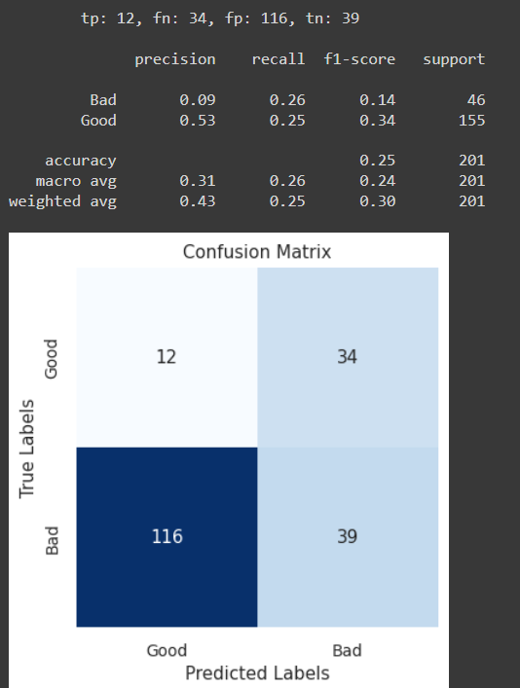
With Size Model in
App Testing
results in RDS

Slide 8
With Size Model in Manual Testing

Slide 9
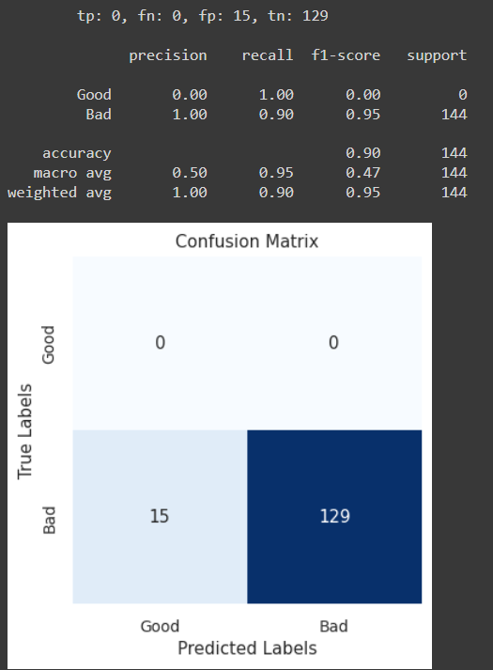
11-June-24

Slide 10
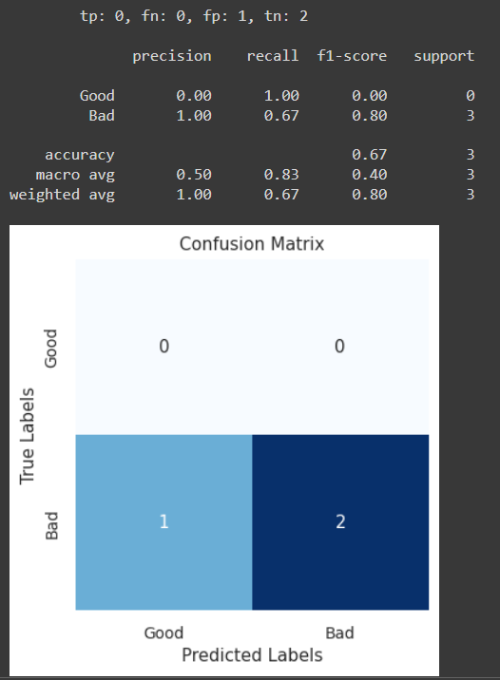
04-July-24

Slide 11
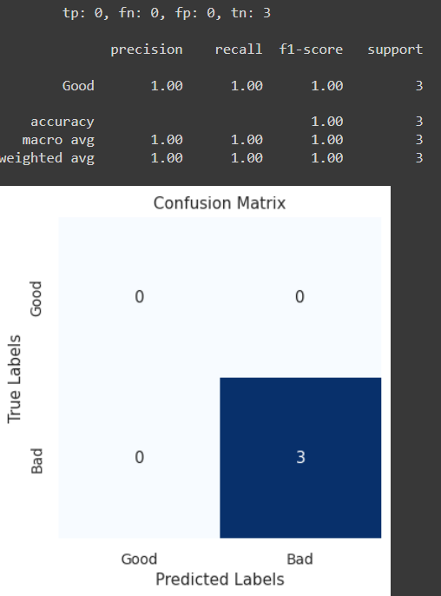
11-July-24

Slide 12
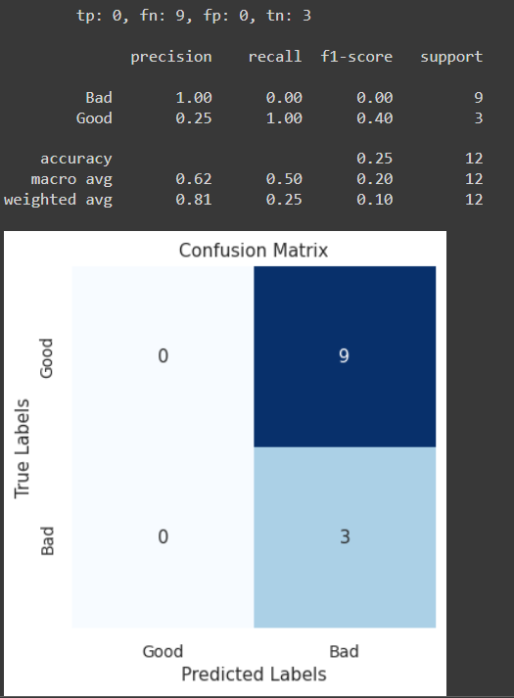
16-July-24

Slide 13
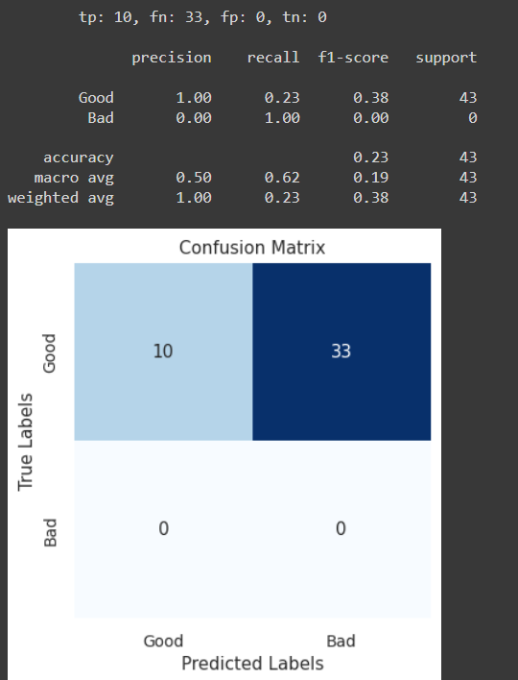
30-July-24

Slide 14
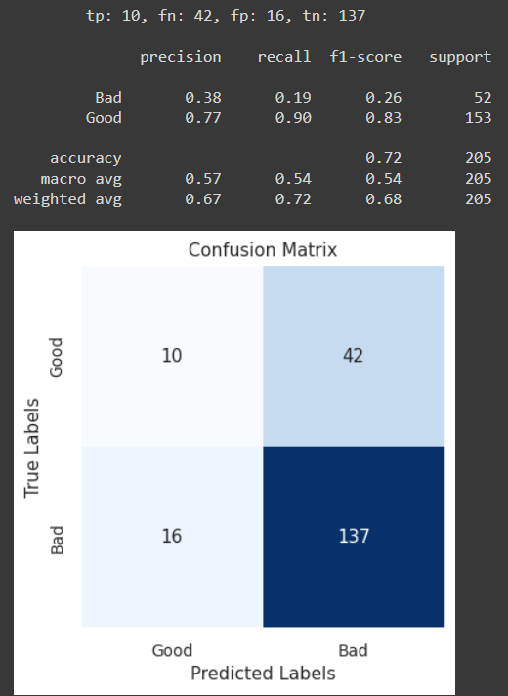
Overall

Slide 15
Without Size Model in Manual Testing

Slide 16
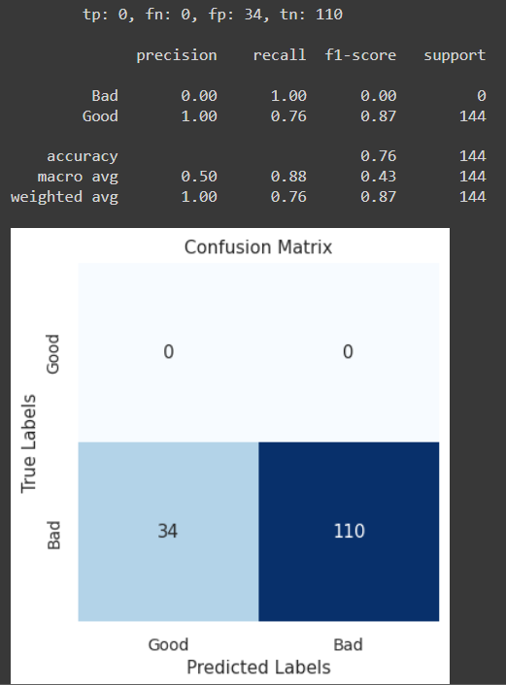
11-June-24

Slide 17
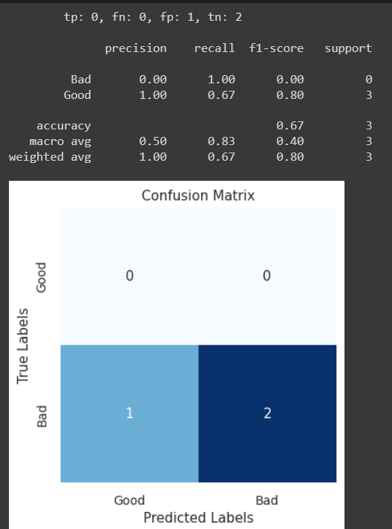
04-July-24

Slide 18

11-July-24

Slide 19
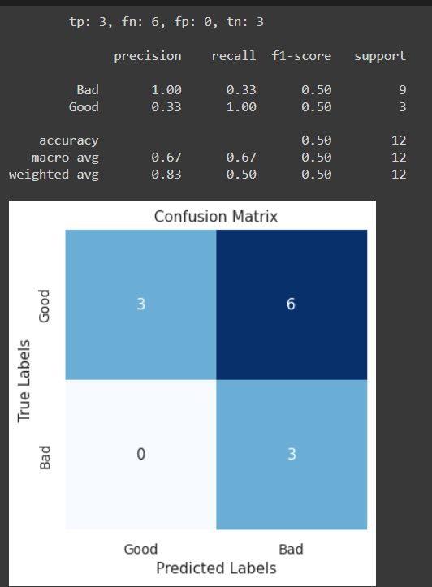
16-July-24

Slide 20
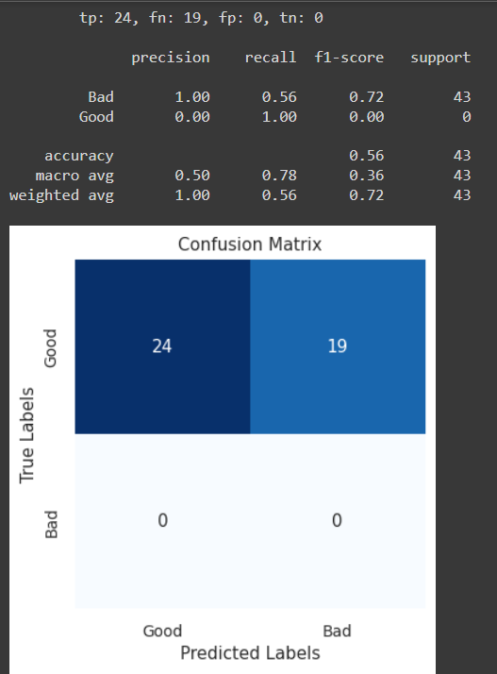
30-July-24

Slide 21
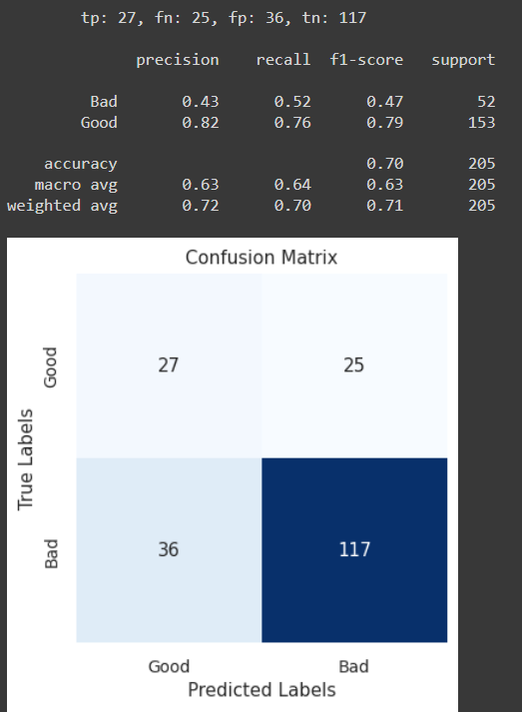
Overall

Slide 22
Without Size Model but with if condition with fishheight in Manual Testing

Slide 23
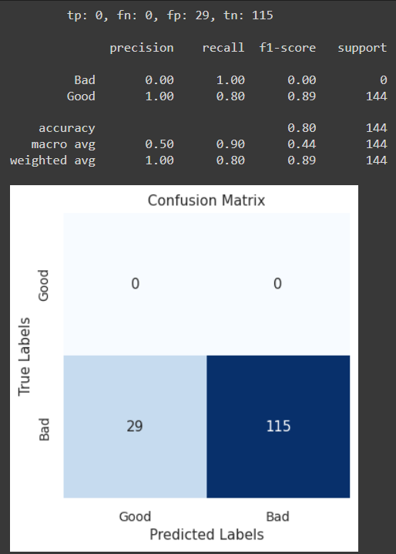
11-June-24

Slide 24
04-July-24

Slide 25
11-July-24

Slide 26
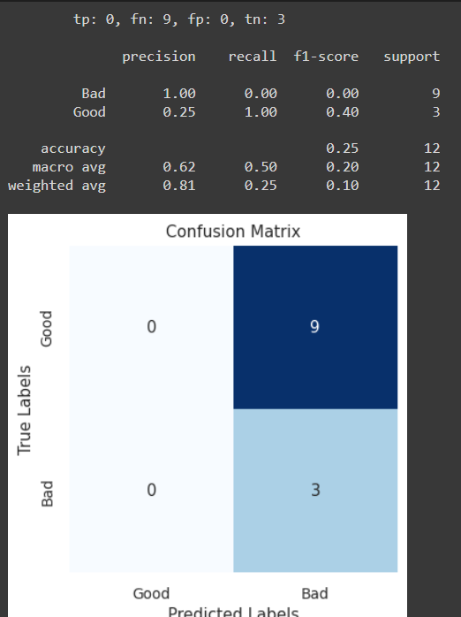
16-July-24

Slide 27
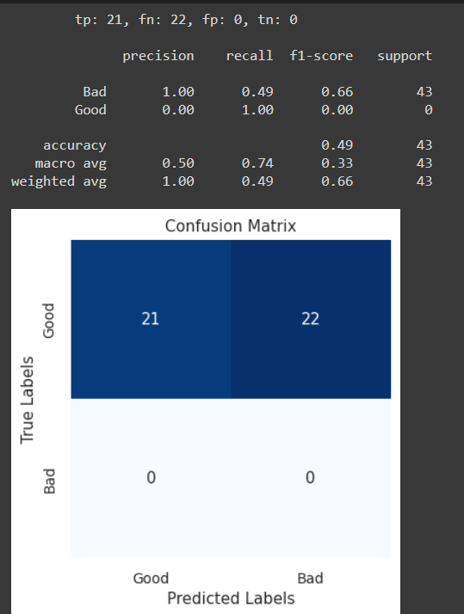
30-July-24

Slide 28
Without Size Model but with if condition with fishdiagonal in Manual Testing

Slide 29
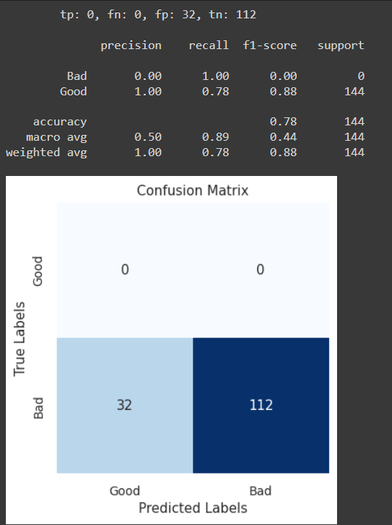
11-June-24

Slide 30
04-July-24

Slide 31
11-July-24

Slide 32
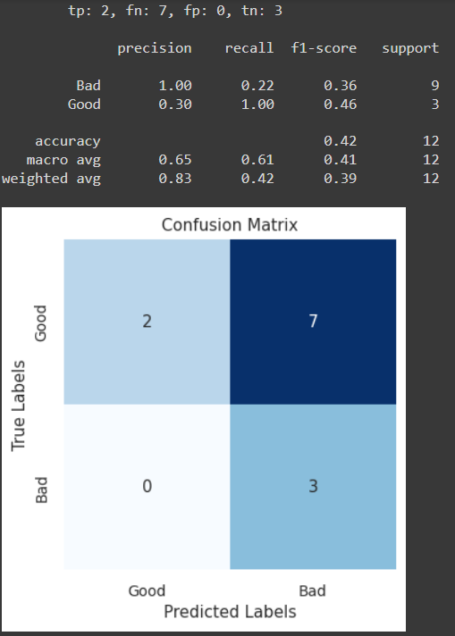
16-July-24

Slide 33
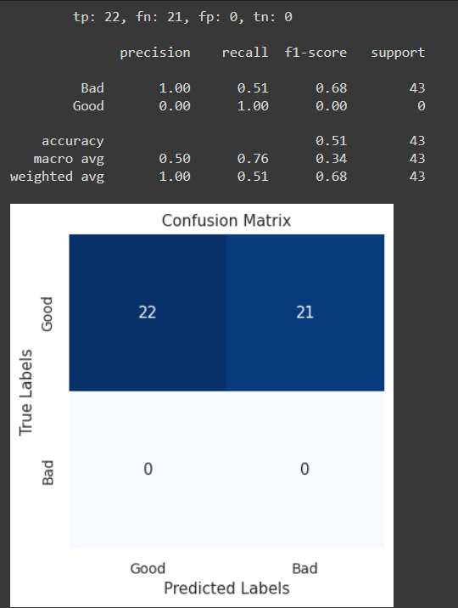
30-July-24

